Slide 1
Uva 10911
Forming Quiz Teams
Time: 3 seconds

Slide 2
Problem Description
You have been given the job of forming the quiz teams for the next ‘MCA CPCI Quiz Championship’.
There are 2*N students interested to participate and you have to form N teams, each team consisting of two members.
Since the members have to practice together, all the students want their members house as near as possible. Let x₁ be the distance between the houses of group 1, x₂ be the distance between the houses of group 2 and so on. You have to make sure the summation (x₁+x₂+x₃+. . .+x_{n}) is minimized.

Slide 3
Input
There will be many cases in the input file. Each case starts with an integer N (N <=8).
The next 2*N lines will given the information of the students. Each line starts with the students name, followed by the x coordinate and then the y coordinate.
Both x, y are integers in the range 0 to 1000.
Students’ name will consist of lowercase letters only and the length will be at most 20.
Input is terminated by a case where N is equal to 0.

Slide 4
Output
For each case, output the case number followed by the summation of the distances, rounded to 2 decimal places.
Follow the sample for exact format.

Slide 5

Sample Input / Output
N
name, x, y
5
sohel 10 10
mahmud 20 10
sanny 5 5
prince 1 1
per 120 3
mf 6 6
kugel 50 60
joey 3 24
limon 6 9
manzoor 0 0
1
derek 9 9
jimmy 10 10
0
Case 1: 118.40
Case 2: 1.41
per(50,60)
joey(3,24)
sohel(10,10)
mahmud(20,10)
limon(6,9)
mf(6,6)
sanny(5,5)
per(120,3)
manzoor(0,0)
prince(1,1)
end of test case

Slide 6
Bitset (用於狀態壓縮)
每一格代表一位選手
枚舉所有 j
i
32
2⁹ | 2⁸ | 2⁷ | 2⁶ | 2⁵ | 2⁴ | 2³ | 2² | 2¹ | 2⁰
 |  |  |  | 1 | 1 | 1 | 1 | 1 | 1
2⁹ | 2⁸ | 2⁷ | 2⁶ | 2⁵ | 2⁴ | 2³ | 2² | 2¹ | 2⁰
 |  |  |  |  | 1 | 1 | 1 | 1
2⁹ | 2⁸ | 2⁷ | 2⁶ | 2⁵ | 2⁴ | 2³ | 2² | 2¹ | 2⁰
 |  |  |  |  | 1 | 1 | 1 |  | 1
dp[32]=min {dp[32], dp[15]+d[5,0],
dp[14]+d[5,1],…

Slide 7
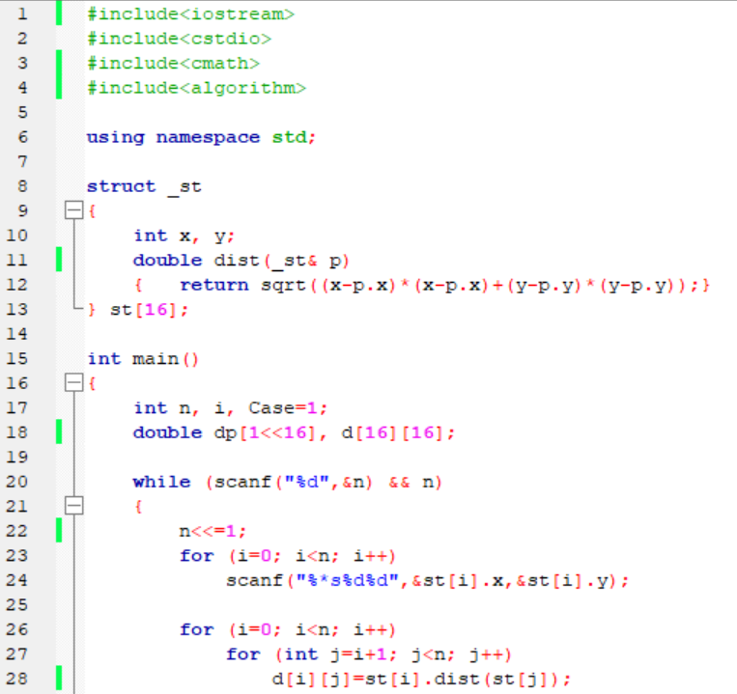

Slide 8
